Slide 1
EDGE OF GLORY

Slide 2
What’s holding you back? (constraints)
Keep it real - what’s keeping you stuck?
Locus of control - is this within my control or influence?

Slide 3

Keeping me stuck
Things I can’t control

Slide 4

Making room for what you love (boundaries)
Thinking about your why statement, what do you need more or less of to show up with full mojo?

Slide 5
Maximise
Minimise
Notes:
Create a new canvas for this

Slide 6
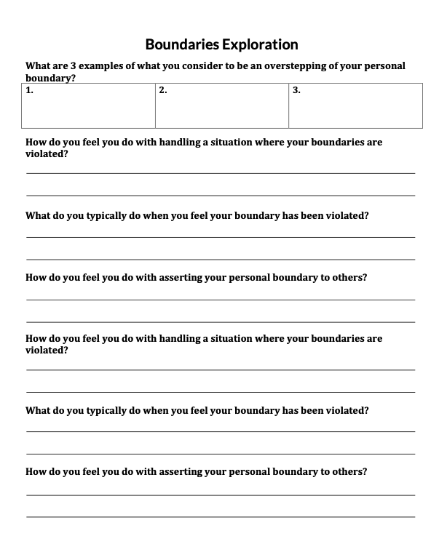

Slide 7
Are your beliefs holding you back? Which one(s)?

Slide 8
Belief flip
Are there better beliefs that serve you?
How could you reframe them to support you with your goals?

Slide 9
Name and frame
What change do you seek?
Who is it for?
What can’t be changed (constraints)?

Slide 10
The change
Who it’s for
This can’t be changed
Notes:
Create a new canvas for this

